Slide 1
NASA DRL Support for S-NPP Direct Broadcast Users
Patrick Coronado
Presented by:
Shahid Habib
Fritz Policelli
Office of Applied Sciences - GSFC
directreadout.sci.gsfc.nasa.gov

Slide 2
Supporting S-NPP Users
Enabling Applications through real-time science algorithms and data tools.
In-house Efforts:
To provide a real-time data processing framework providing a processing environment for direct readout science algorithms using real-time directly broadcasted spacecraft or network-based science instrument data.
- Development is comprised of three elements:
Enabling Technologies: packet processing, raw data format converters, real-time data visualization and comparison tools, real-time data product distribution mechanisms and tools.
Direct Readout Processing Framework (science data processing system): IPOPP - the International Polar-Orbiter Processing Package
Science Processing Algorithms: SPA – as modules running within IPOPP that generate xDRs products
Operational Mission algorithms and science research algorithms ported to run in a direct readout or real-time environment

Slide 3
IPOPP Development Methodology
Users are an integral part of the development process

Slide 4
Science Processing Algorithms (SPA)
SPAs are self contained, individually package instrument algorithms that generate SDRs and EDRs
SPAs execute at command line or within the IPOPP framework.
The SPA concept enables efficient and rapid algorithm updates – plug and play within the IPOPP framework

Slide 5
Title
IPOPP Architecture

Slide 6
Recent SPA Releases
Following NOAA Operational Algorithms updated to version 1.5.08.04 (Mx8.4):
GTMIMAGERY
The VIIRS Ground Track Mercator Imagery Science Processing Algorithm (GTMIMAGERY SPA) produces mission-compliant HDF5 output for the GTM Imaging Band Imagery Environmental Data Record (EDR), GTM Moderate Band Imagery EDR, and GTM Near Constant Contrast (NCC) Band Imagery EDR. The SPA functions in two modes: Standalone, or as an IPOPP plug-in (IPOPP v2.3 or later required).
ACTIVEFIRES
The ACTIVEFIRES_SPA takes as input VIIRS Moderate Resolution Sensor Data Record (SDR) and Terrain-Corrected Geolocation products, and produces the mission-compliant VIIRS Active Fires Application Related Product (ARP) that also contains the Fire Mask (extended capability).
AEROSOL
The AEROSOL_SPA takes as input VIIRS Moderate Resolution Band SDR and Terrain-Corrected Geolocation products, the VIIRS Cloud Mask Intermediate Product (IP), and meteorological ancillary, and produces the mission-compliant Aerosol Optical Thickness (AOT) IP, Aerosol Model Index (AMI) IP, Aerosol Environmental Data Record (EDR), Suspended Matter (SM) EDR, and Aerosol Geolocation HDF5 product.

Slide 7
Recent SPA Releases (Cont.)
LST (Land Surface Temperature)
The LST_SPA takes as inputs the VIIRS M12, M13, M15, and M16 band SDR products; the VIIRS M-band Terrain-Corrected Geolocation product; the VIIRS Cloud Mask IP; and (optionally) the Aerosol Optical Thickness (AOT) IP, and produces the VIIRS LST Environmental Data Record (EDR) product.
SNOWCOV (Snow Cover)
The SNOWCOV_SPA takes as input the VIIRS I1, I2, I3, I5, M15, and M16 band SDR products; the VIIRS M-Band Terrain-Corrected Geolocation product; the VIIRS I-Band Terrain-Corrected Geolocation product; the VIIRS Cloud Mask Intermediate Product (IP); and the VIIRS Aerosol Optical Thickness IP and produces the mission-compliant Snow Binary Map EDR and Snow Fraction EDR.
SURFREFLECT (Surface Reflectance)
The SURFREFLECT_SPA takes as inputs VIIRS M-band Sensor Data Record (SDR) products; VIIRS I-band SDR products; the VIIRS M-Band Terrain-Corrected Geolocation product; the VIIRS I-Band Terrain-Corrected Geolocation product; the VIIRS Cloud IP; the Aerosol Optical Thickness IP; and the Aerosol Model Index IP and meteorological ancillary, and produces the mission-compliant VIIRS Surface Reflectance HDF5 IP.
VEGINDEX (Vegetation Index)
The VEGINDEX_SPA takes as inputs VIIRS I1 and I2 band SDR products; the VIIRS I-band Terrain-Corrected Geolocation product; and the VIIRS Surface Reflectance Intermediate Product (IP) and produces the mission-compliant VIIRS Vegetation Index EDR product.

Slide 8
Recent SPA Releases (Cont.)
COP (Cloud Optical Properties) SPA
The COP_SPA takes as inputs VIIRS Moderate Resolution Band SDR and Terrain-Corrected Geolocation products, the VIIRS Cloud Mask IP, and meteorological ancillary to produce mission-compliant VIIRS Cloud Optical Properties IP and VIIRS Ice & Night Water Cloud Top Temperature HDF5 IP.
CLOUDMASK
The CLOUDMASK_SPA takes as input VIIRS I1, I2, I4, I5, M1, M4, M5, M7, M8, M9, M10, M11, M12, M13, M14, M15, and M16 band SDR products; the VIIRS M-Band Terrain-corrected Geolocation product; the VIIRS Active Fire Product and meteorological ancillaries. The SPA produces the mission-compliant Cloud Mask IP HDF5 product.
___________________________________________________________________________
Following NOAA Operational Algorithms updated to version 1.5.08.05 (Mx8.5):
C-SDR SPA v1.8
The Common Sensor Data Record Science Processing Algorithm (C-SDR_SPA) processes SNPP VIIRS, ATMS and CrIS Raw Data Record (RDR) HDF5 files into corresponding instrument-specific and mission-compliant HDF5 SDR and Geolocation single granule or swath products. The SPA functions in two modes: Standalone, or as an IPOPP plug-in (IPOPP v2.3 required).

Slide 9
Recent Processing Tool Releases
IPOPP v2.3
IPOPP v2.3 produces SNPP - VIIRS, CrIS, ATMS, and OMPS output, while still producing Terra/Aqua MODIS output in the same package
RT-STPS v5.6
The Real-time Software Telemetry Processing System (RT-STPS) is a generalized CCSDS data processing package. RT-STPS is a Java application that ingests telemetry data from a spacecraft transmission in real-time or from an equivalent demodulated file, performs multi-mission protocol processing including link-layer artifact corrections, provides data integrity statistics, and produces output to a file or TCP/IP socket.

Slide 10
Coming Soon to the DRL (Cont.)
- NASA Evaluation Algorithms -
VIIRS-AF SPA v1.3.1
The VIIRS Active Fires Science Processing Algorithm (VIIRS-AF SPA) primarily uses brightness temperatures derived from bands M13 and M15 to detect fires.
OMPSNadir SPA v1.0.1
The Ozone Mapping and Profiler Suite (OMPS) nadir processing Science Processing Algorithm (OMPSNADIR_SPA) takes as input two OMPS Raw Data Record (RDR) files in mission-standard format (RNSCA-RONPS and RNSCA-ROTCS).
VIIRS-SDR SPA (Land SIPS RDR/SDR/GEO)
The Imagery Resolution SDRs contain the calibrated reflective and emissive data at 375m for Bands I1 through I5. The Moderate Resolution SDR contains the calibrated reflective and emissive data at 750m for Bands M1 through M16. The Day/Night Band (DNB) SDR contains the reflective data at 375m for the DNB Band. The Geolocation products are available in Moderate, Imagery and terrain corrected DNB.

Slide 11
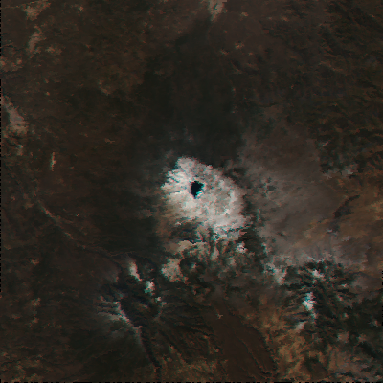
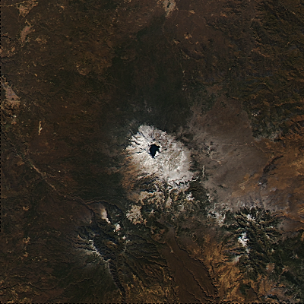
Coming Soon to the DRL - NASA Evaluation Algorithms -
CREFL SPA - True Color Sharpening
User-requested IPOPP capability
Aqua MODIS 250m True Color produced by H2G_SPA ; Mt Paektu Volcano, N Korea/China; Nov 10, 2014
Before Scan Geometry Based Resampling and Sharpening
After Scan Geometry Based Resampling and Sharpening

Slide 12
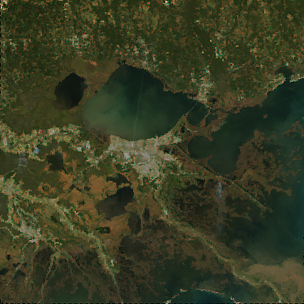
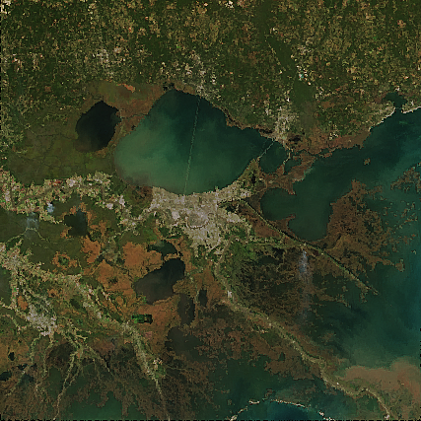
CVIIRS SPA - True Color Sharpening
Coming Soon to the DRL (Cont.)
- NASA Evaluation Algorithms -
User-requested IPOPP capability
VIIRS 375m True Color produced by H2G_SPA / New Orleans, USA; Nov 11, 2014
Before Sharpening
After Sharpening

Slide 13
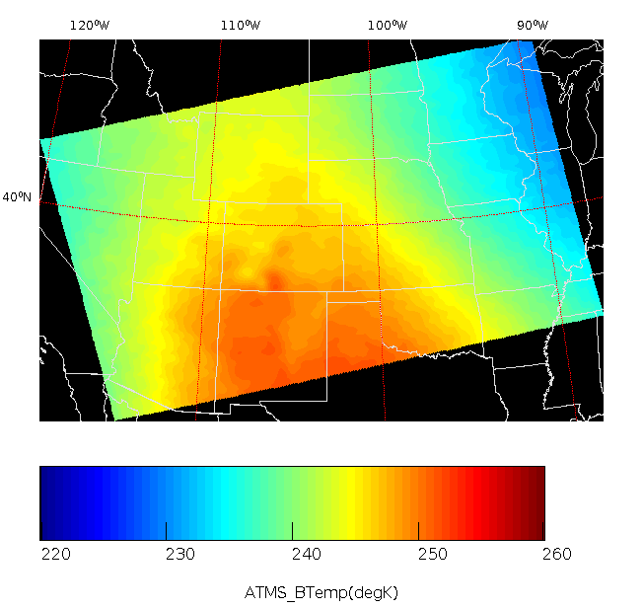
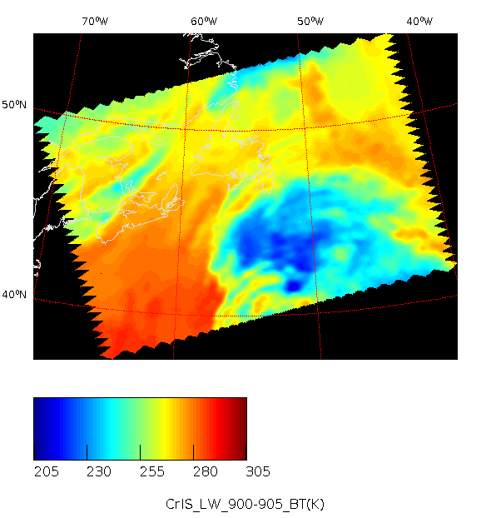
ATMS and CrIS Imagery: new in H2G_SPA
Coming Soon to the DRL (Cont.)
- NASA Evaluation Algorithms -
User-requested IPOPP capability, extends C-SDR SPA
ATMS Ch 6 Brightness Temperature, Nov 13 2014, Southern USA
Produced by H2G_SPA
CrIS LW Brightness Temperature, Nov 13, 2014, Nova Scotia, Canada
Produced by H2G_SPA

Slide 14
NASA Direct Program is Driven by User Participation
For additional SPAs and data processing tool see:
http://direcreadout.sci.gsfc.nasa.gov

Slide 15
Additional Background

Slide 16
IPOPP Distributed Architecture and Standard Interfaces
DSx
DS2
Front End System
(FES)
Data System (DS)
Control System (CS)
Data Storage Manager (DSM)
Information Services (IS)
Status/Event Logging System (SLS)
Real-Time Software Telemetry Processing System (RT-STPS)
Simulcast
Science Processing Algorithms (SPAs)

Slide 17
Real-Time Software Telemetry
Processing Software (RT-STPS)
Raw S-NPP Packet Processing to RDR (Level-0)

Slide 18
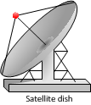
Simulcast – Real-time Distributed
Instrument Data Monitoring

